Slide 2
Operating SYSTEMS aND Systems Programming (CT30A3370) 6 credits
January 17, 2023
Venkata Marella

Slide 3
INTRODUCTION TO OPERATING SYSTEM AND COMPUTER ARCHITECTURE

Slide 4
What is An OPErATING SYSTEM
First thing that comes to your mind when you here “Operating System”
System software that acts as an interface b/w user and computer
What is System Software?
A software that manages the resources of the system (device)
What are the resources of the system (laptop)
Processor, Memory, I/O devices, etc
Silberschatz, Galvin Operating System Concepts – 7th Edition and Gagne ©2005

Slide 5
Why Do YOU NEED OPERATING SYSTEM
Goals of the Operating Systems:
Provide resources to execute users’ program
Use the hardware in an efficient manner
Make the system convenient to use
Silberschatz, Galvin Operating System Concepts – 7th Edition and Gagne ©2005

Slide 6
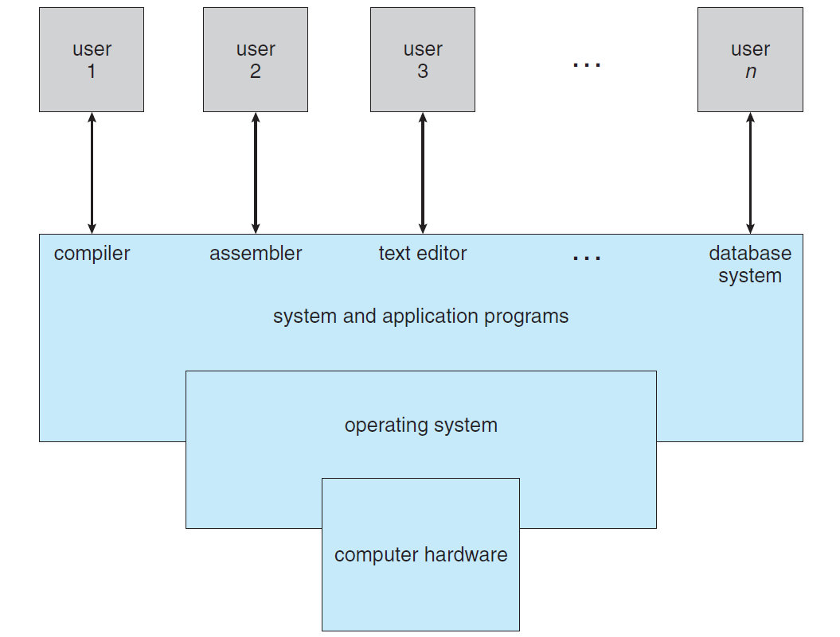
COMPONENTS of Operating Systems
Silberschatz, Galvin Operating System Concepts – 7th Edition and Gagne ©2005
Notes:
The operating system controls the hardware and coordinates its use among the various application programs for the various users.
An operating system is similar to a government. Like a government, it performs no useful function by itself.
It simply provides an environment within which other programs can do useful work.

Slide 7
How hard each component has evolved!
WISC computer developed by Univ of Wisconsin
Silberschatz, Galvin Operating System Concepts – 7th Edition and Gagne ©2005
Notes:
Wisconsin Integrally Synchronized Computer
1954

Slide 8
The Logic Module used by Apollo guidance computer, putting a
Man on the moon with a computer that had 36KB of memory
Silberschatz, Galvin Operating System Concepts – 7th Edition and Gagne ©2005

Slide 9
Operating System Definition
OS is a resource allocator
● Manages all resources
● Decides between conflicting requests for efficient and fair resource use
OS is a control program
● Controls execution of programs to prevent errors and improper use of the computer
Silberschatz, Galvin Operating System Concepts – 7th Edition and Gagne ©2005

Slide 10
Operating System Definition
No universally accepted definition
“Everything a vendor ships when you order an operating system” is good approximation
But varies wildly
“The one program running at all times on the computer” is the kernel. Everything else is either a system program (ships with the operating system) or an application program
Silberschatz, Galvin Operating System Concepts – 7th Edition and Gagne ©2005
Notes:
system programs, which are associated with the operating system but are not necessarily part of the kernel, and application programs, which include all
programs not associated with the operation of the system.)
middleware—a set of software frameworks that provide additional services to application developers.
A modern general-purpose computer system consists of one or more CPUs and a number of device controllers connected through a common bus that
provides access to shared memory (Figure 1.2). Each device controller is in charge of a specific type of device (for example, disk drives, audio devices,
or video displays). The CPU and the device controllers can execute in parallel, competing for memory cycles. To ensure orderly access to the shared memory,
a memory controller synchronizes access to the memory.
For a computer to start running—for instance, when it is powered up or
rebooted—it needs to have an initial program to run. This initial program,
or bootstrap program, tends to be simple. Typically, it is stored within
the computer hardware in read-only memory (ROM) or electrically erasable
programmable read-only memory (EEPROM), known by the general term
firmware. It initializes all aspects of the system, from CPU registers to device
controllers tomemorycontents. The bootstrap program mustknowhowto load
the operating system and how to start executing that system.

Slide 11
Computer Startup
Bootstrap program is loaded at power-up or reboot
● Typically stored in ROM or EEPROM, generally known as firmware
● Initializes all aspects of system from CPU registers to device controllers to memory contents
● Loads operating system kernel and starts execution
Silberschatz, Galvin Operating System Concepts – 7th Edition and Gagne ©2005

Slide 12
Computer System Organization
Computer-system operation
● One or more CPUs, device controllers connect through common bus providing access to shared memory
● Concurrent execution of CPUs and devices competing for memory cycles
Silberschatz, Galvin Operating System Concepts – 7th Edition and Gagne ©2005
Notes:
A modern general-purpose computer system consists of one or more CPUs and a number of device controllers connected through a common bus that
provides access to shared memory
Each device controller is in charge of a specific type of device (for example, disk drives, audio devices, or video displays). The CPU and the device controllers can execute in parallel, competing for memory cycles. To ensure orderly access to the shared memory, a memory controller synchronizes access to the memory. Each device controller is in charge of a specific type of device (for example, disk drives, audio devices, or video displays). The CPU and the device controllers can execute in parallel, competing for memory cycles. To ensure orderly access to the shared memory, a memory controller synchronizes access to the memory.
For a computer to start running—for instance, when it is powered up or rebooted—it needs to have an initial program to run. This initial program,
or bootstrap program, tends to be simple. Typically, it is stored within the computer hardware in read-only memory (ROM) or electrically erasable
programmable read-only memory (EEPROM), known by the general term firmware. It initializes all aspects of the system, from CPU registers to device
controllers to memory content. The bootstrap program must know how to load the operating system and how to start executing that system.
Bootstrap program needs to know where the kernel program of the OS is located and should be loaded into the memory.
Once the kernel is loaded and executing, it can start providing services to the system and its users
Once the kernel is loaded and executing, it can start providing services to
the system and its users. Some services are provided outside of the kernel, by
system programs that are loaded into memory at boot time to become system
processes, or system daemons that run the entire time the kernel is running.
On UNIX, the first system process is “init,” and it starts many other daemons.
Once this phase is complete, the system is fully booted, and the system waits
for some event to occur.

Slide 13
Computer-System Operation
I/O devices and the CPU can execute concurrently.
Each device controller is in-charge of a particular device type.
Each device controller has a local buffer.
CPU moves data from/to main memory to/from local buffers
I/O is from the device to local buffer of controller.
Device controller informs CPU that it has finished its operation by causing an interrupt (via system bus).
Silberschatz, Galvin Operating System Concepts – 7th Edition and Gagne ©2005

Slide 14
Common Functions of Interrupts
Interrupt transfers control to the interrupt service routine generally, through the interrupt vector, which contains the addresses of all the service routines.
Interrupt architecture must save the address of the interrupted instruction.
Incoming interrupts are disabled while another interrupt is being processed to prevent a lost interrupt.
A trap is a software-generated interrupt caused either by an error or a user request (the latter is often referred to as a system call).
An operating system is interrupt driven.

Slide 15
Interrupt Handling
■ The operating system preserves the state of the CPU by storing registers and the program counter.
■ Determines which type of interrupt has occurred:
● polling by a generic routine
● vectored interrupt system
■ Separate segments of code determine what action should be taken for each type of interrupt

Slide 16
I/O Structure
After I/O starts, control returns to user program only upon I/O completion.
Wait instruction idles the CPU until the next interrupt
Wait loop (contention for memory access).
At most one I/O request is outstanding at a time, no simultaneous I/O processing.
After I/O starts, control returns to user program without waiting for I/O completion.
System call – request to the operating system to allow user to wait for I/O completion.
Device-status table contains entry for each I/O device indicating its type, address, and state.
Operating system indexes into I/O device table to determine device status and to modify table entry to include interrupt.

Slide 17
Device-STATUS Table

Slide 18
Direct Memory Access Structure
Used for high-speed I/O devices able to transmit information at close to memory speeds.
Device controller transfers blocks of data from buffer storage directly to main memory without CPU intervention.
Only one interrupt is generated per block, rather than the one interrupt per byte.

Slide 19
Storage structure
Main memory – only large storage media that the CPU can access directly.
Secondary storage – extension of main memory that provides large nonvolatile storage capacity.
Magnetic disks – rigid metal or glass platters covered with magnetic recording material
Disk surface is logically divided into tracks, which are subdivided into sectors.
The disk controller determines the logical interaction between the device and the computer.

Slide 20
Storage Hierarchy
Storage systems organized in hierarchy.
Speed
Cost
Volatility
Caching – copying information into faster storage system; main memory can be viewed as a last cache for secondary storage.

Slide 21
Storage-Device Hierarchy

Slide 22
Caching
Important principle, performed at many levels in a computer (in hardware, operating system, software)
Information in use copied from slower to faster storage temporarily – Speed mismatch
Faster storage (cache) checked first to determine if information is there
If it is, information used directly from the cache (fast)
If not, data copied to cache and used there
Cache smaller than storage being cached
Cache management important design problem
Cache size and replacement policy

Slide 23
Performance of Various Levels of Storage
Movement between levels of storage hierarchy can be explicit or implicit

Slide 24
Migration of Integer A from Disk to Register
Multitasking environments must be careful to use most recent value, no matter where it is stored in the storage hierarchy
Multiprocessor environment must provide cache coherency in hardware such that all CPUs have the most recent value in their cache
Distributed environment situation even more complex
Several copies of a datum can exist
Various solutions covered in Chapter 17

Slide 25
Operating System Structure
Multiprogramming needed for efficiency (CPU utilization)
Single user cannot keep CPU and I/O devices busy at all times
Multiprogramming organizes jobs (code and data) so CPU always has one to execute
A subset of total jobs in system is kept in memory
One job selected and run via job scheduling
When it has to wait (for I/O for example), OS switches to another job
Timesharing (multitasking) is logical extension in which CPU switches jobs so frequently that users can interact with each job while it is running, creating interactive computing (interactivity)
Response time should be < 1 second
Each user has at least one program executing in memory process
If several jobs ready to run at the same time CPU scheduling
If processes don’t fit in memory, swapping moves them in and out to run
Virtual memory allows execution of processes not completely in memory
Notes:
A multiprogramming operating system is one that can execute multiple programmes simultaneously on a single processor. In an operating system with multiple programmes, other programmes use the CPU and other resources while one programme waits for an I/O transfer.

Slide 26
Memory Layout for Multiprogrammed System

Slide 27
Operating-System Operations
Interrupt driven by hardware
Software error or request creates exception or trap
● Division by zero, request for operating system service
Other process problems include infinite loop, processes modifying each other or the operating system
Thus we need protection:
Dual-mode operation allows OS to protect itself and other system components
User mode and kernel mode
Mode bit provided by hardware
Provides ability to distinguish when system is running user code or kernel code
Some instructions designated as privileged, only executable in kernel mode
System call changes mode to kernel, return from call resets it to user

Slide 28
Transition from User to Kernel Mode
Timer to prevent infinite loop / process hogging resources
Set interrupt after specific period
Operating system decrements counter
When counter zero generate an interrupt
Set up before scheduling process to regain control or terminate program that exceeds allotted time
Notes:
We need two separate modes of operation: user mode and kernel mode (also called supervisor mode, system mode, or privileged mode).
A bit, called the mode bit, is added to the hardware of the computer to indicate the current mode: kernel (0) or user (1).
With the mode bit, we can distinguish between a task that is executed on behalf of the operating system and one that is executed on behalf of the user.
At system boot time, the hardware starts in kernel mode. The operating system is then loaded and starts user applications in user mode. Whenever a
trap or interrupt occurs, the hardware switches from user mode to kernel mode (that is, changes the state of the mode bit to 0). Thus, whenever the operating system gains control of the computer, it is in kernel mode. The system always switches to user mode (by setting the mode bit to 1) before passing control to a user program.
The dual mode of operation provides us with the means for protecting the operating system from errant users—and errant users from one another.
The hardware allows privileged instructions to be executed only in kernel mode. If an attempt is made to execute a privileged instruction in user mode, the hardware does not execute the instruction but rather treats it as illegal and traps it to the operating system.

Slide 29
Process Management
A process is a program in execution. It is a unit of work within the system. Program is a passive entity, process is an active entity.
Process needs resources to accomplish its task
CPU, memory, I/O, files
Initialization data
Process termination requires reclaim of any reusable resources
Single-threaded process has one program counter specifying location of next instruction to execute
Process executes instructions sequentially, one at a time, until completion
Multi-threaded process has one program counter per thread
Typically system has many processes, some user, some operating system running concurrently on one or more CPUs
Concurrency by multiplexing the CPUs among the processes / threads
Notes:
The dual mode of operation provides us with the means for protecting the
operating system from errant users—and errant users from one another

Slide 30
Process Management Activities
The operating system is responsible for the following activities in connection with process management:
Creating and deleting both user and system processes
Suspending and resuming processes
Providing mechanisms for process synchronization
Providing mechanisms for process communication
Providing mechanisms for deadlock handling

Slide 31
Memory Management
All data must be in memory before and after processing
All instructions must be in memory in order to execute
Memory management determines what is in memory when
Optimizing CPU utilization and computer response to users
Memory management activities
Keeping track of which parts of memory are currently being used and by whom
Deciding which processes (or parts thereof) and data to move into and out of memory
Allocating and deallocating memory space as needed

Slide 32
Storage management
OS provides uniform, logical view of information storage
Abstracts physical properties to logical storage unit – file
Each medium is controlled by device (i.e., disk drive, tape drive)
Varying properties include access speed, capacity, data-transfer rate, access method (sequential or random)
File-System management
Files usually organized into directories
Access control on most systems to determine who can access what
OS activities include
Creating and deleting files and directories
Primitives to manipulate files and dirs
Mapping files onto secondary storage
Backup files onto stable (non-volatile) storage media

Slide 33
Mass-Storage Management
Usually disks used to store data that does not fit in main memory or data that must be kept for a “long” period of time.
Proper management is of central importance
Entire speed of computer operation hinges on disk subsystem and its algorithms
OS activities
Free-space management
Storage allocation
Disk scheduling
Some storage need not be fast
Tertiary storage includes optical storage, magnetic tape
Still must be managed
Varies between WORM (write-once, read-many-times) and RW (read-write)

Slide 34
I/O systems
One purpose of OS is to hide peculiarities of hardware devices from the user – ease of usage & programming
I/O subsystem responsible for
Memory management of I/O including buffering (storing data temporarily while it is being transferred), caching (storing parts of data in faster storage for performance), spooling (the overlapping of output of one job with input of other jobs)
General device-driver interface
Drivers for specific hardware devices

Slide 35
Protection and security
Protection – any mechanism for controlling access of processes or users to resources defined by the OS
■ Security – defense of the system against internal and external attacks
● Huge range, including denial-of-service, worms, viruses, identity theft, theft of service
■ Systems generally first distinguish among users, to determine who can do what
● User identities (user IDs, security IDs) include name and associated number, one per user
● User ID then associated with all files, processes of that user to determine access control
● Group identifier (group ID) allows set of users to be defined and controls managed, then also associated with each process, file
● Privilege escalation allows user to change to effective ID with more rights

Slide 36
Computing environments
Traditional computer
Blurring over time
Office environment
PCs connected to a network, terminals attached to mainframe or minicomputers providing batch and timesharing
Now portals allowing networked and remote systems access to same resources
Home networks
Used to be single system, then modems
Now firewalled, networked

Slide 37
Computing Environments (Cont.)

Slide 38
Computing Environments (Cont.)
Client-Server Computing
Dumb terminals supplanted by smart PCs
Many systems now servers, responding to requests generated by clients
Compute-server provides an interface to client to request services (i.e. database)
File-server provides interface for clients to store and retrieve files

Slide 39
Peer-to-Peer Computing
Another model of distributed system
P2P does not distinguish clients and servers
Instead all nodes are considered peers
May each act as client, server or both
Node must join P2P network
Registers its service with central lookup service on network, or
Broadcast request for service and respond to requests for service via a discovery protocol
Examples include Napster and Gnutella

Slide 40
Web-Based Computing
Web has become ubiquitous
PCs most prevalent devices
More devices becoming networked to allow web access
New category of devices to manage web traffic among similar servers: load balancers
Use of operating systems like Windows 95, client-side, have evolved into Linux and Windows XP, which can be clients and servers
Web based office software! http://Docs.google.com

